Slide 1


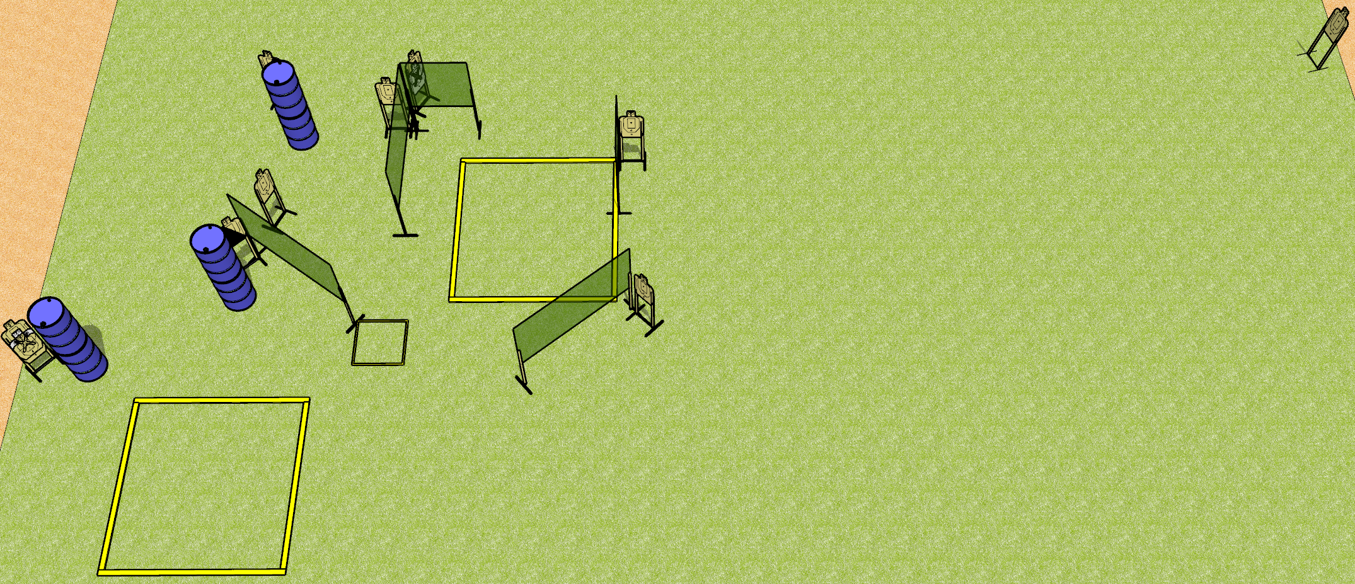
 | Dothan Gun Club – USPSA Match Hop Around Course Designer : Drew Coleman
Round Count 20 rounds 10 USPSA
Equipment List 9 wall feet 1 shooting box 1 left and 1 right diag Use 10’ fault lines for other boxes

Slide 2
Hop Around
Written Stage Briefing
Hop Around is a 20 round, 100 point, Comstock course of fire. There are 10 USPSA targets. The best 2 hits on paper will score. The start signal is audible.
Handgun start position is in the middle shooting area, wrists below belt. Handgun is loaded and holstered.
PCC start position is in the middle shooting area, stock on belt. Loaded carbine is held with both hands, safety on.
On start signal, engage targets as they become available from within the shooting areas.

Slide 3
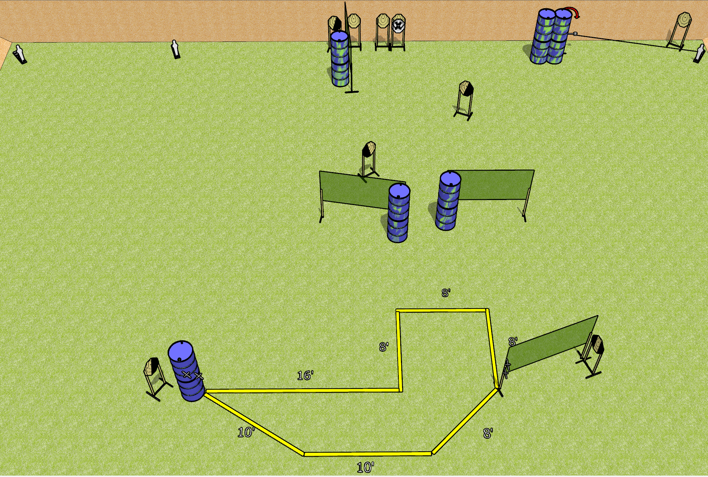
 | Dothan Gun Club – USPSA Match Shuffle Course Designer : Drew Coleman
Round Count 23 rounds 10 IPSC 3 mini poppers
Equipment List 8 wall feet Swinger + activator 1 left diag and 3 right diag, 1 tux

Slide 4
Shuffle
Written Stage Briefing
Shuffle is a 23 round, 115 point Comstock course of fire. There are 10 IPSC targets and 3 mini poppers. The best 2 hits on paper will score, and steel must fall to score. The start signal is audible.
The swinger is activated by the right mini popper and remains visible at rest.
Handgun start position is both hands touching either set of marks, feet completely outside the shooting area. Handgun is loaded and holstered.
PCC start position is muzzle touching any mark, stock on belt, feet completely outside the shooting area. Carbine is loaded, safety on.
On start signal engage targets as they become available from within the shooting area.

Slide 5
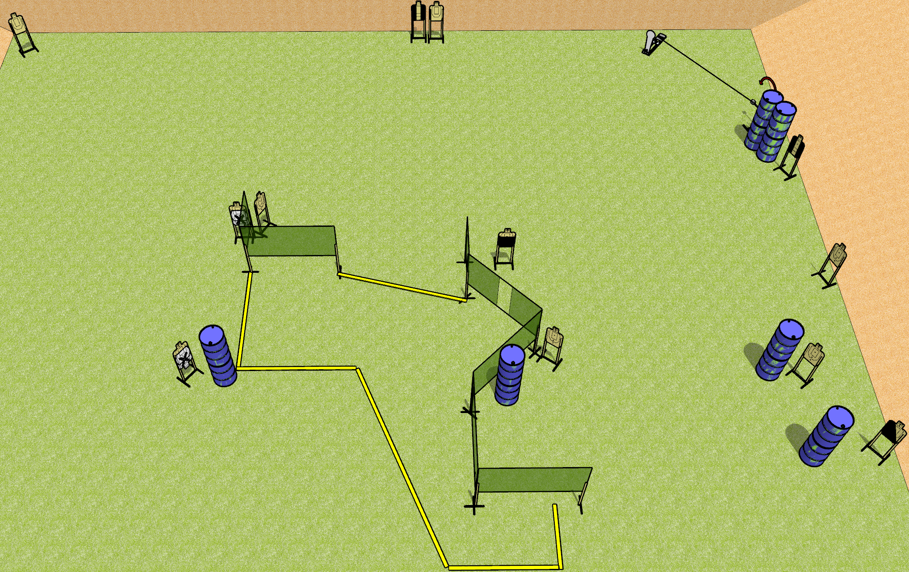
 | Dothan Gun Club – USPSA Match Low Go Course Designer : Drew Coleman
Round Count 25 rounds 11 USPSA 1 Colt popper, 2 plates
Equipment List 11 wall feet 1 medium fault line Red stitch target + activator 1 50%, 2 tux, 1 left diag USE RED STITCH PLATE SWINGER FOR SWINGER
Wall with 2 ports

Slide 6
Low Go
Written Stage Briefing
Low Go is a 25 round, 125 point, Comstock course of fire. There are 11 USPSA targets,1 colt popper, and 2 falling plates. The best 2 hits on paper will score, and steel must fall to score. The start signal is audible.
The swinger is activated by the colt popper and remains visible at rest.
Handgun start position is anywhere completely outside the shooting area, wrists below belt. Handgun is loaded and holstered.
PCC start position is anywhere completely outside the shooting area, stock on belt. Loaded carbine is held with both hands, safety on.
On start signal, engage targets as they become available from within the shooting area.

Slide 7
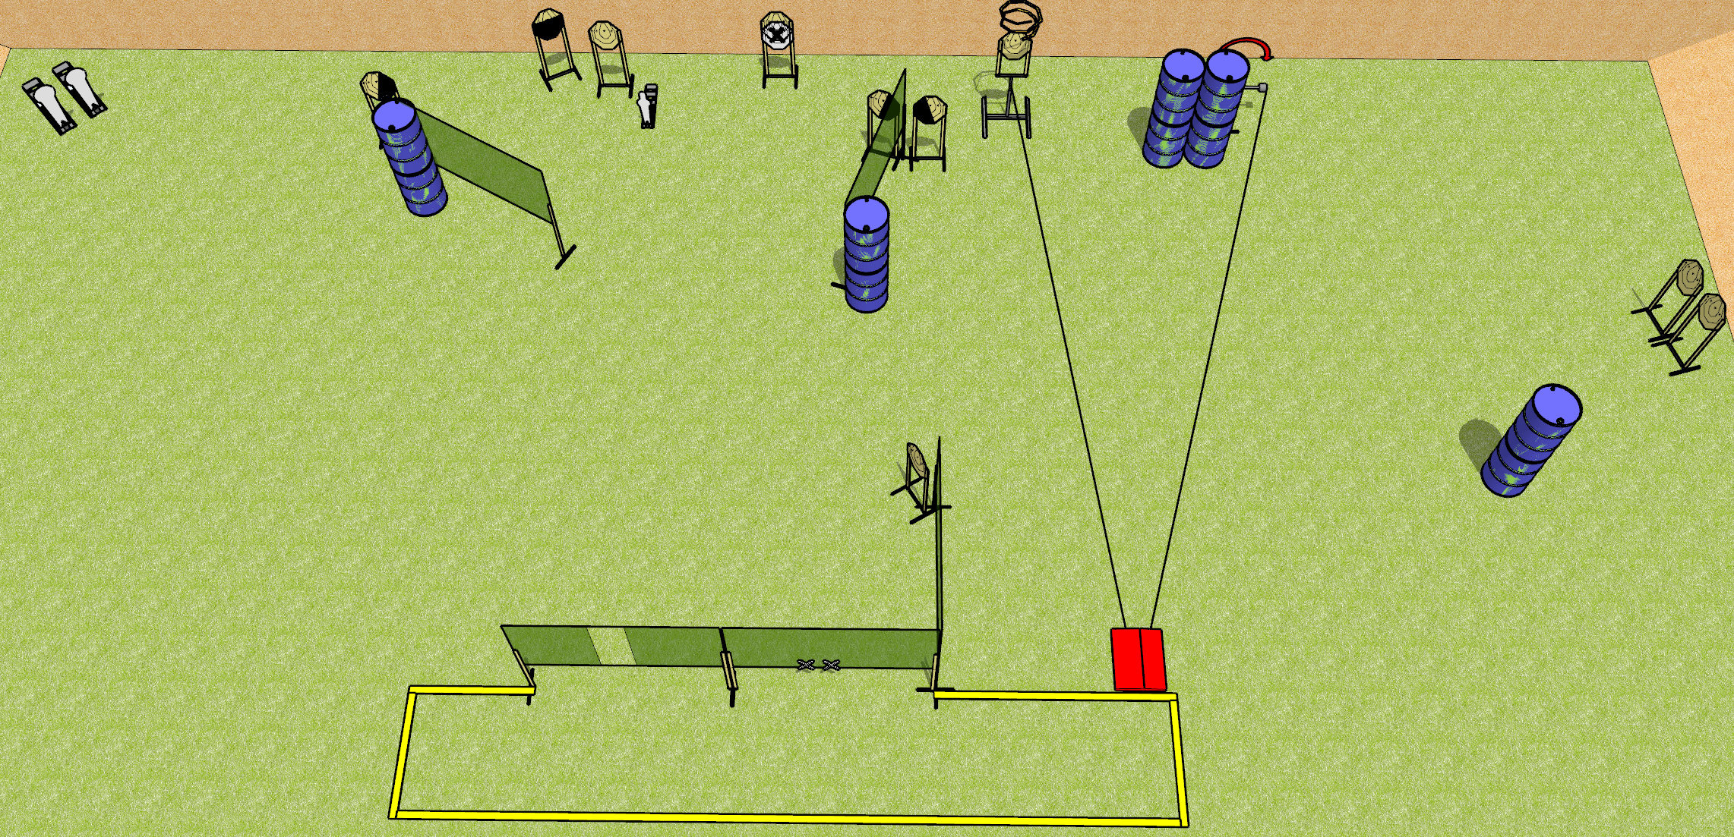
 | Dothan Gun Club – USPSA Match Stomping Grounds Course Designer : Drew Coleman
Round Count 25 rounds 11 IPSC 2 colt, 1 mini
Equipment List 8 wall feet 3 medium fault lines Stomp box + swinger + turner 1 left + 2 right diag, 1 50%

Slide 8
Stomping Grounds
Written Stage Briefing
Stomping Grounds is a 25 round, 125 point, Comstock course of fire. There are 11 IPSC targets, 2 colt poppers, and 1 mini popper. The best 2 hits on paper will score and steel must fall to score. The start signal is audible.
The turner and swinger are both activated by the stomp box. The turner is a disappearing target and the swinger remains visible at rest. The stomp box is NOT part of the shooting area.
Handgun start position is both hands touching marks. Handgun is loaded and holstered.
PCC start position is muzzle touching either mark, stock on belt. Loaded carbine is held with both hands, safety on.
On start signal, engage targets as they become available from within the shooting area.

Slide 9
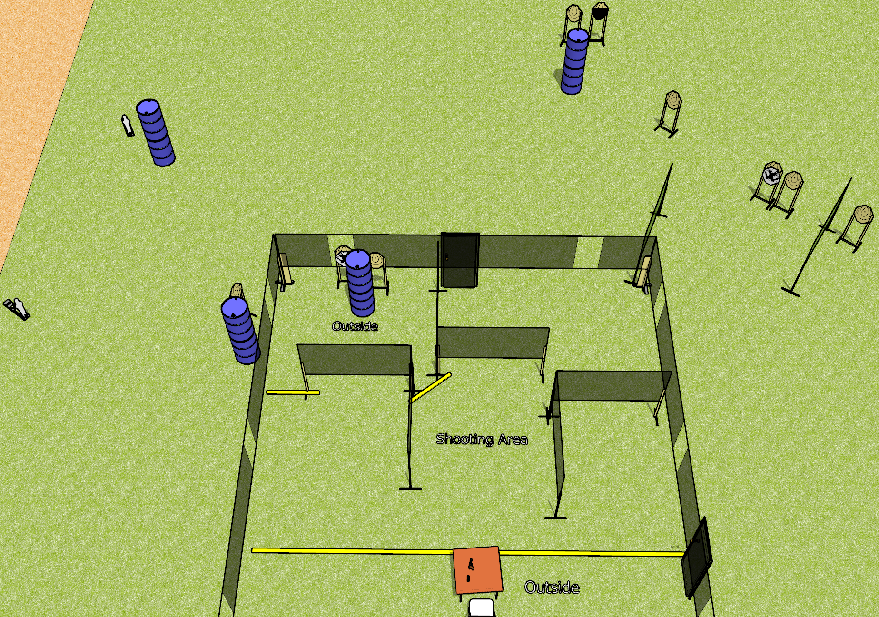
 | Dothan Gun Club – USPSA Match Take a Load Off Course Designer : Drew Coleman
Round Count 29 rounds 9 IPSC 2 mini poppers
Equipment List 4 wall feet 2 small fault lines Table + chair

Slide 10
Take a Load Off
Written Stage Briefing
Take a Load Off is a 29 round, 145 point, Comstock course of fire. There are 9 IPSC targets and 2 mini poppers. The best 3 hits on paper will score, and steel must fall to score. The start signal is audible.
Doors must be shut prior to start signal. See diagram or Drew/Patrick/Dan if there is confusion on what defines the shooting area.
Start position is seated in chair, back against back of chair, hands on knees. Firearm is on table, trigger guard on either mark, first magazine to be used on stage on other mark.
On start signal, engage targets as they become available from within the shooting area.

